Slide 1


Harassment at

Slide 2

The case
You are a staff member at the Nitroba University Incident Response Team.
Lily Tuckrige is teaching chemistry CHEM109 this summer at NSU.
Tuckrige has been receiving harassing email at her personal email address.
  Tuckrige's personal email is lilytuckrige@yahoo.com
  She thinks that it is from one of the students in her class.
Tuckrige contacted IT support.
  She sent a screen shot of one of the harassing email messages.
  She wants to know who is doing it.
istockphoto.com

Slide 3
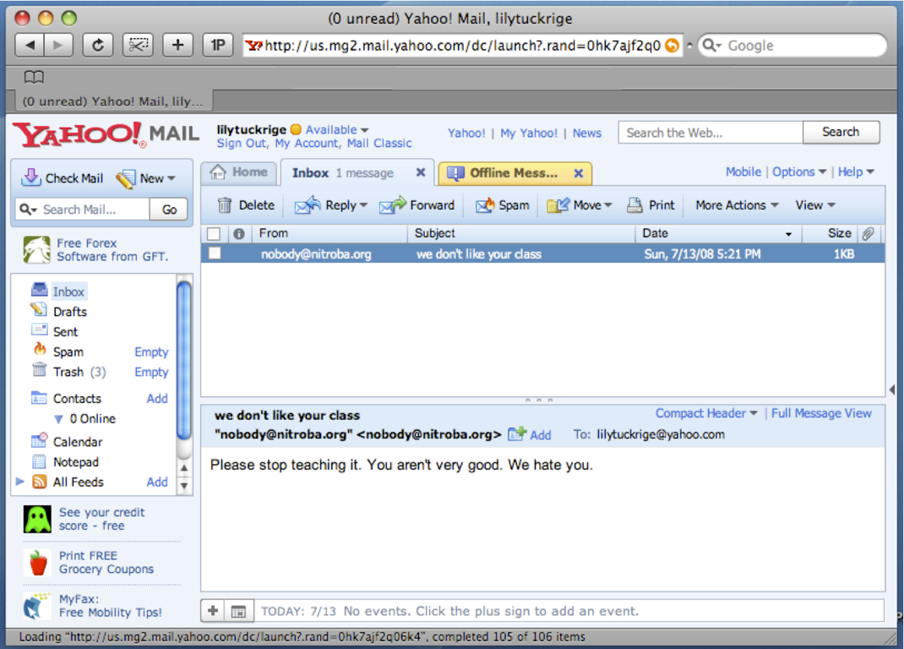
The email message.

Slide 4
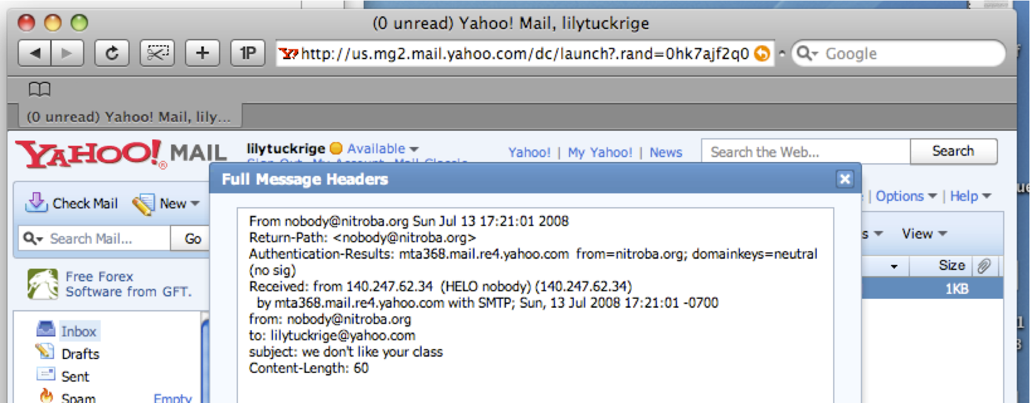
Nitroba's IT wrote back to Lily.
The IT tech told Lily:
  The screen shot wasn't tremendously useful.
  Can you get the full headers?
Lily sent back a screen shot with the headers:

Slide 5
The IP address points to a nitroba dorm room.
$ host 140.247.62.34
34.62.247.140.in-addr.arpa domain name pointer G24.student.nitroba.org
$

Slide 6
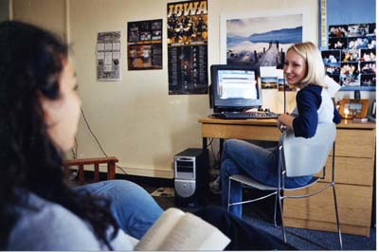

The Dorm Room
Three women share the room:
  Alice
  Barbara
  Candice
Nitroba provides 10mbps Ethernet in every room but no Wi-Fi.
Barbara's boyfriend Kenny installed a Wi-Fi router in the room.
There is no password on the router.
photo credit: epa.gov

Slide 7
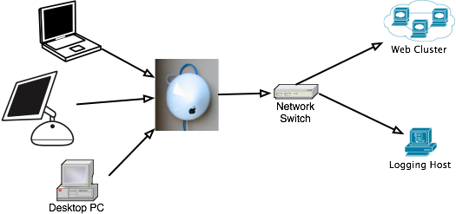
To find out what's going on,
Nitroba's IT sets up a packet sniffer
Who is sending the harassing mail?

Slide 8

Now we wait

Slide 9
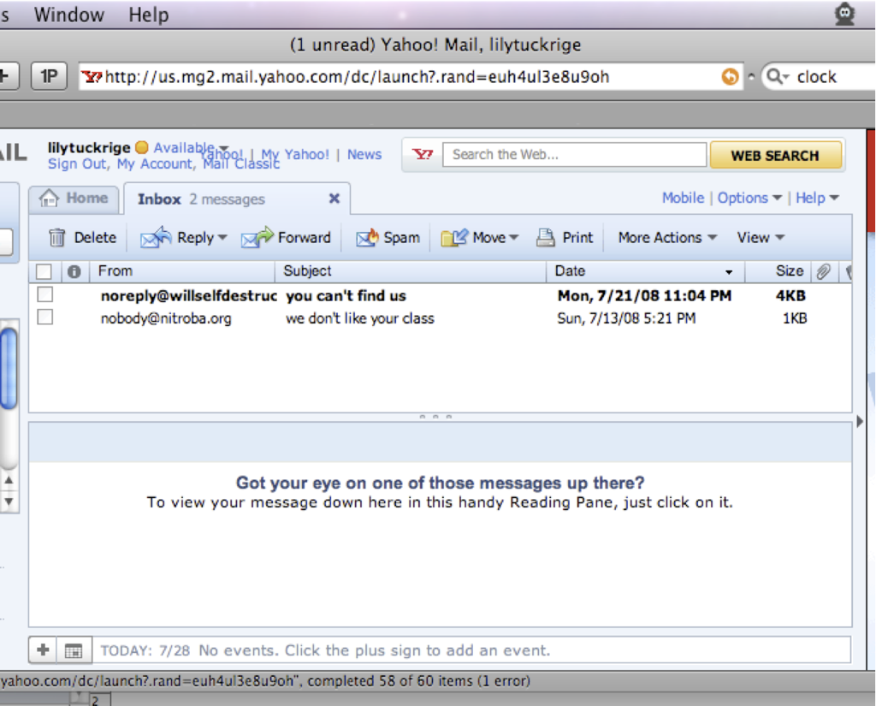
The guy attacked!

Slide 10
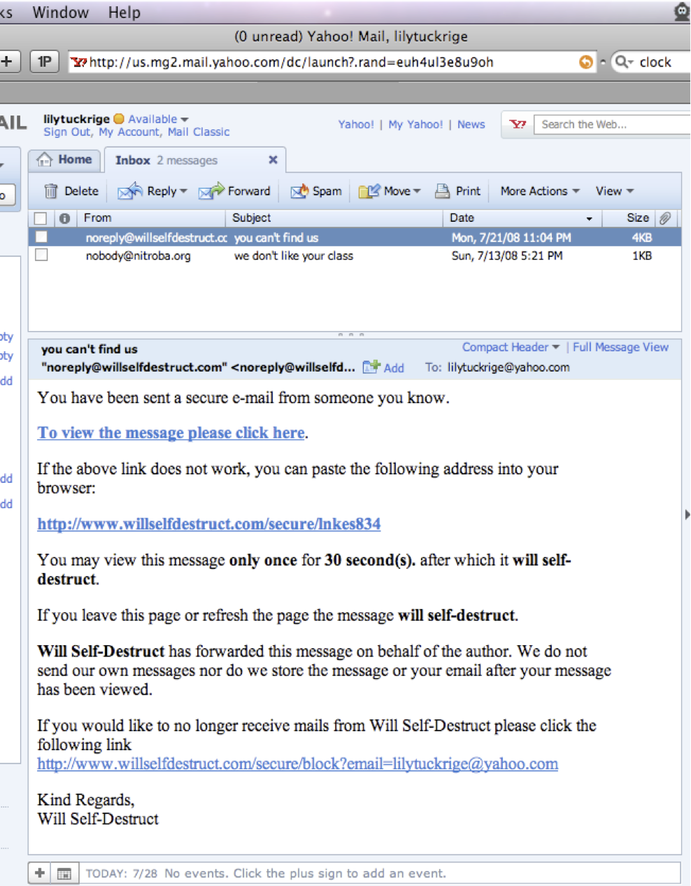
And here is the message:

Slide 11
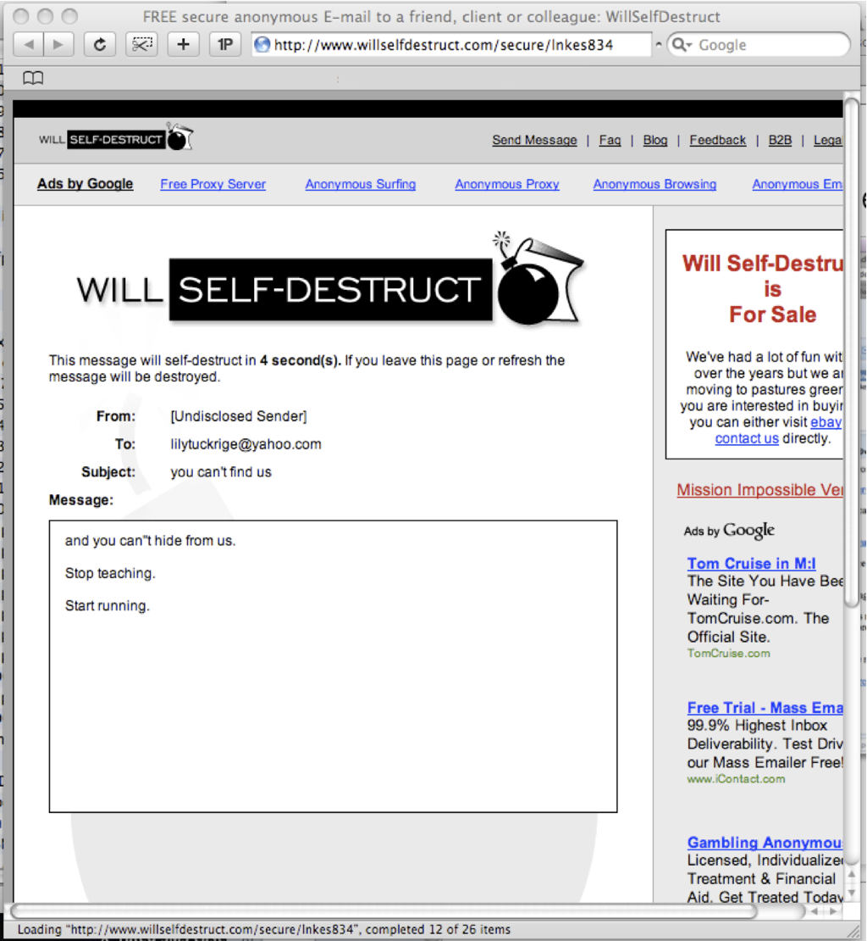
No, here is the message

Slide 12

And there goes the message:

Slide 13
So who did it?
Chemistry 109 class list:
Teacher: Lily Tuckrige
Students:
Amy Smith
Burt Greedom
Tuck Gorge
Ava Book
Johnny Coach
Jeremy Ledvkin
Nancy Colburne
Tamara Perkins
Esther Pringle
Asar Misrad
Jenny Kant

Slide 14
How to solve this problem:
Map out the Nitroba dorm room network.
Find who sent email to lilytuckrige@yahoo.com
  Look for a TCP flow that includes the hostile message
  Find information that can tie that message to a particular web browser.
Identify the other TCP connections that below to the attacker
Find information in one of those TCP connections that IDs the attacker.

